Slide 1
Software Engineering
Intermediate Report

Slide 2
1. About our Application
2. Scrum
3. SRS
4. Analysis Model
I n d e x

Slide 3
About our application
1

Slide 4
HYUⓔmini
Objective
“Simplicity is the ultimate sophistication.”
Leonardo da Vinci
Notes:
HYUⓔmini Project는 기존의 한양대학교 애플리케이션에서 학생들에게 자주 이용되는 필수적인 기능만을 추출하여 좀 더 사용하기 편하게 리팩토링하여 서비스를 제공하기 위해 시작되었습니다.

Slide 5
HYUⓔmini
Target User
Original
HYUⓔmini
Seoul Campus Professor Academy
Employee
… Too Complex!
ERICA Student ONLY!
Notes:
기존의 한양대학교 애플리케이션은 서울캠퍼스, ERICA캠퍼스의 모든 학부생, 교직원, 사무원, 대학원생이 사용했다면,
저희 애플리케이션은 오로지 ERICA 캠퍼스의 학부생만을 타겟으로하여 더 쉽게, 더 간편하게 필요한 기능에 접근하게끔 만들었습니다.

Slide 6


HYUⓔmini
Target Platform

Slide 7
HYUⓔmini
Stakeholder
Prof. Scott Lee
Manager (School)
Ten Developers
ERICA Students

Slide 8
Scrum
2

Slide 9
Why?
Why are we select Scrum?
Speed up development
Can introduce XP partially.
Notes:
이터레이션 중에 요구사항 변경이 없음.
효율적인 분업
빠른 개발
주기적인 요구사항 리뉴얼

Slide 10
How?
How can we apply Scrum to our project?
Free Member Switching
Apply XP Methodology
Daily Scrum Meeting

Slide 11
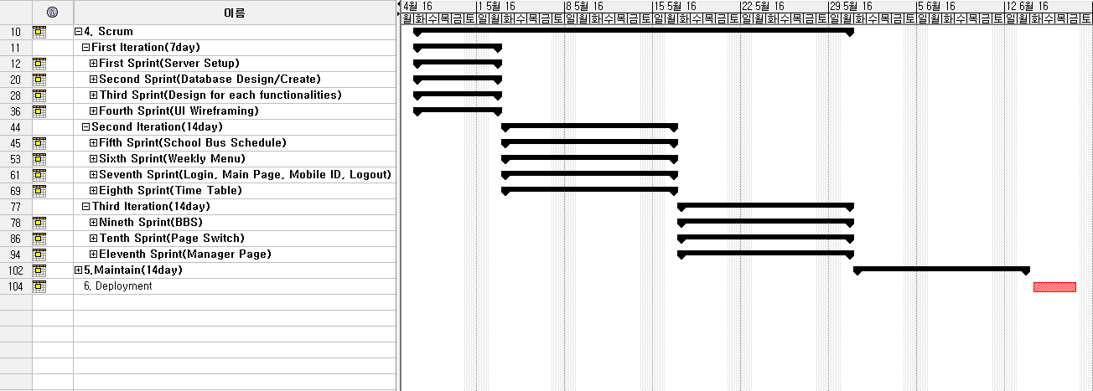
Scrum planning
Gantt Chart

Slide 12
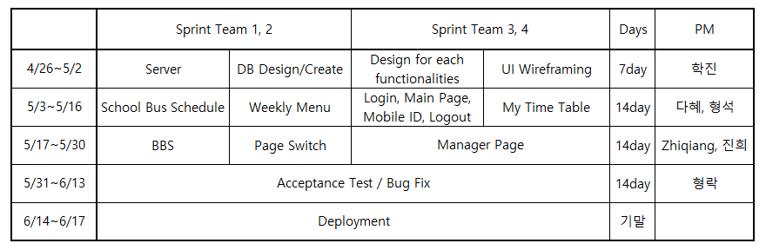
Scrum planning
Four Sprints / Iteration.

Slide 13
SRS
3

Slide 14
SRS Format
Introduction
Purpose
Scope of Project
Glossary
Overview of Document

Slide 15
SRS Format
Overall Description
System Environment
User Characteristics
Use Cases
Use Case 1: Login System
Description
Use Case Diagram
Use Case 2: Main Page
…

Slide 16
SRS Format
Requirements Specification
Use Case1: Login System
Functional Requirement1: …
Functional Requirement2: …
…
Non-functional Requirement5: …
…
Use Case2: Main Page
Functional Requirement1: …
…
…
Non Functional Requirements
non-functional requirements 1
non-functional requirements 2
…

Slide 17
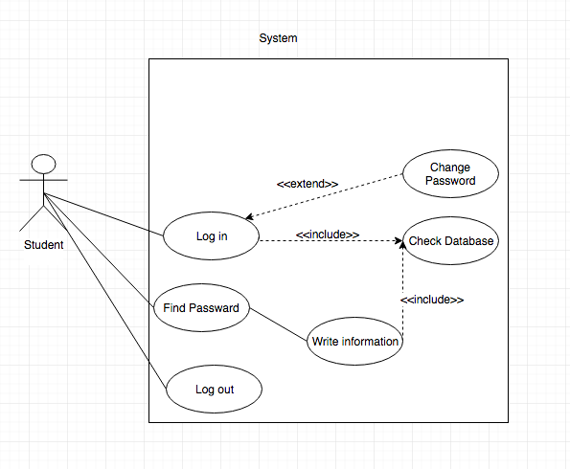
Use Case 1. Login/Logout
Use Case 1. Login/Logout

Slide 18
Use Case 1. Login/Logout
Description(User Scenario)
Want to check information -> 1. Find Password 2. Input ID, Password -> Change password
Functional Requirement
Log-in, Log-out, Find Password, Change Password
Non-Functional Requirement
Easy to know, Simple

Slide 19
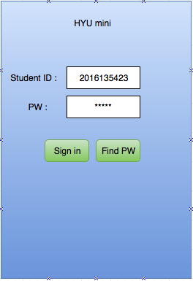
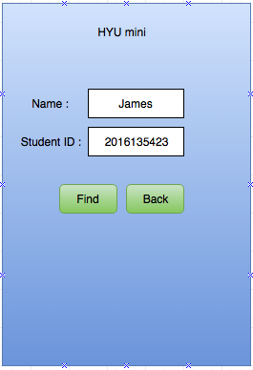
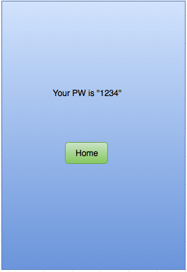
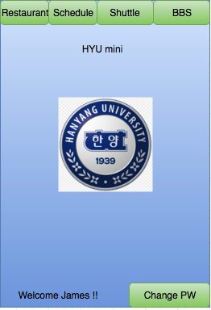
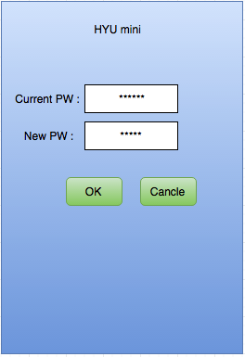
Use Case 1. Login/Logout

Slide 20
Use Case 2. Main Page
Use Case Diagram

Slide 21
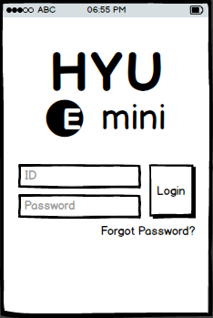
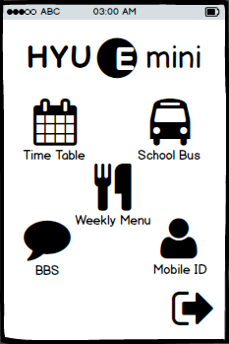

Use Case 2. Main Page
Description(User Scenario)
Login
Succeed
Manager Login
Login Page
Main Page

Slide 22






Use Case 2. Main Page
Requirements
Logout

Slide 23











Use Case 3. BBS
Pre-con. Student accesses into a bulletin board page
Reading Contents
Deleting Contents
Pre-con. Student accesses into the content page
Student or Master logins the application
Reading Writing Deleting Reply
Pre-con. Student accesses into a bulletin board page
Writing Contents
Searching Contents
Notes:
전체 precondition설명

Slide 24

Use Case 3. BBS
Reading Contents
Deleting Contents
Reading Writing Deleting Reply
Writing Contents
Searching Contents
Notes:
기능 설명, Master 가능 기능 설명

Slide 25
Use Case 3. BBS
Pre-con. Student accesses into a bulletin board page
Title
Reading Contents
Deleting Contents
Reading Writing Editing Deleting Reply
Write
input
Writing Contents
Searching Contents
Notes:
Trigger, Pre condition들 설명

Slide 26
Use Case 3. BBS
Reading Contents
Deleting Contents
Pre-con. Student accesses into the content page
Reading Writing
Editing Deleting Reply
Title
Write
Writing Contents
Searching Contents

Slide 27
Use Case 3. BBS
Reading Contents
Deleting
Editing Contents
Delete
Reading Writing
Deleting Editing Reply
Edit
Delete
Pre-con. Student wrote the content before
Edit
Writing Contents
Searching Contents

Slide 28
Use Case 3. BBS
Pre-con. Student accesses into a bulletin board page
Reading Contents
Deleting
Editing Contents
Pre-con. Student accesses into the content page
Reading Writing Deleting
Editing Reply
Pre-con. Student wrote the content before
Writing Contents
Searching Contents

Slide 29
Use Case 4. School Bus Schedule
Use Case 4. School Bus Schedule
Description(User Scenario)를 설명해주세요.
Functional Requirement 어떤 것들 나왔는지 설명해주세요.
Non-Functional Requirement 어떤 것들 나왔는지 설명해주세요.
가능하면 PPT에 글로 때려박지 말고 말로 설명해주세요.
필요하다면 추가 슬라이드를 삽입하셔도 좋습니다.

Slide 30
Use Case 5. Time Table
Description for Time Table
Lecture Schedule is for student who want to see lecture schedule in 'HYUⓔmini'. In addition to basic function of showing lecture schedules, 'HYUⓔmini' also provides highlight view mode of making highlight to current schedule, adding personal schedule function that user can add their personal schedule and sharing function that user can share their schedule through ‘Kakao Talk’. Also user can save their schedule in their local machine 라고 써도 어차피 안보실 거라는 걸 압니다

Slide 31
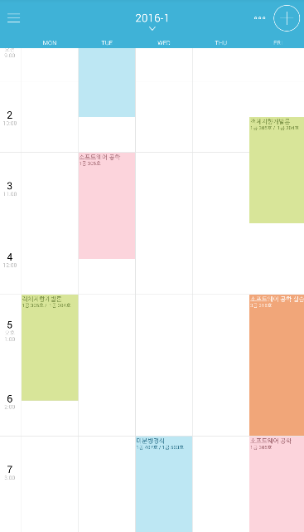

Use Case 5. Time Table
Show Lecture Schedule

Slide 32
Use Case 5. Time Table
Download Schedule

Slide 33
Use Case 5. Time Table
Share Schedule

Slide 34
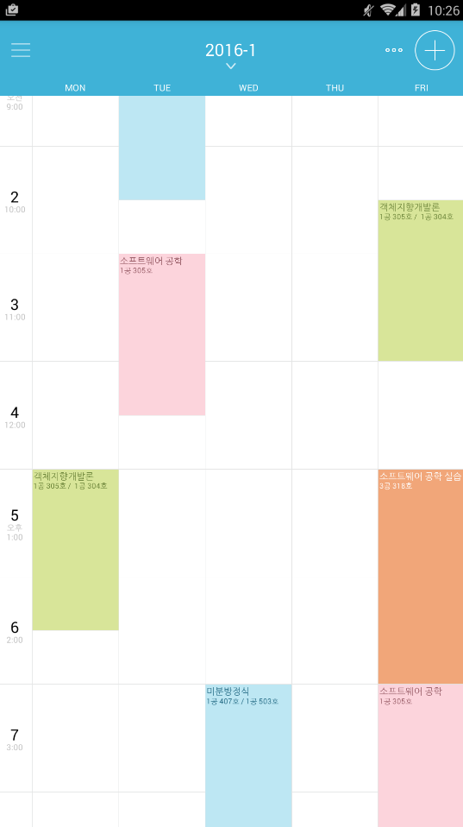

Use Case 5. Time Table
다음 일정 입니다
10:30 AM
Highlight View

Slide 35
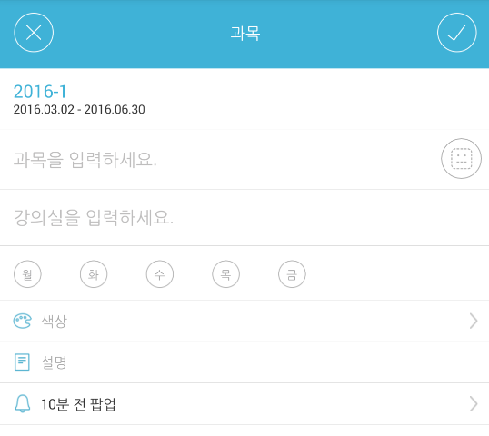

Use Case 5. Time Table
일 정
Add User Schedule
일정을 입력하세요
시간을 입력하세요

Slide 36


Use Case 5. Time Table
Non-Functional
Kakao Talk 이 깔려있어야 합니다!
캡틴 아메리카 방패 급의 보안이 필요합니다!

Slide 37
Use Case 6. Weekly Menu
Use Case Diagram

Slide 38
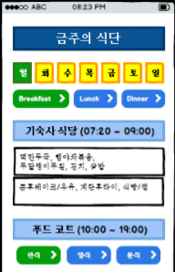
Use Case 6. Weekly Menu
Description(User Scenario)
Button
Pressed

Slide 39
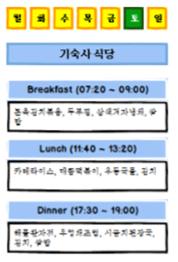
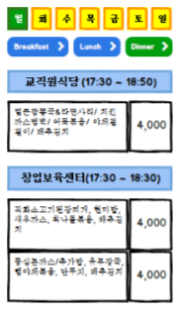
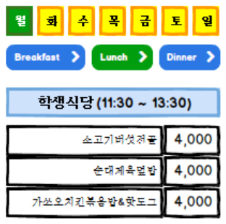
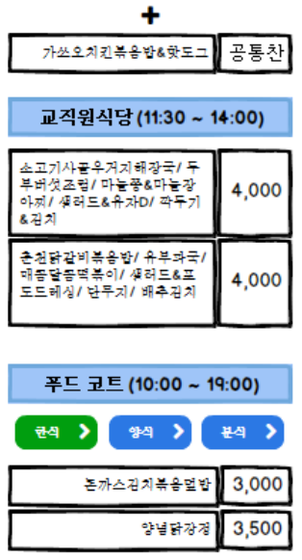
Use Case 6. Weekly Menu
Requirements

Slide 40






Use Case 6. Weekly Menu
Description(User Scenario)
Dragging

Slide 41
Use Case 7. Manager Page
Use Case 7. Manager Page
Description(User Scenario)를 설명해주세요.
Functional Requirement 어떤 것들 나왔는지 설명해주세요.
Non-Functional Requirement 어떤 것들 나왔는지 설명해주세요.
가능하면 PPT에 글로 때려박지 말고 말로 설명해주세요.
필요하다면 추가 슬라이드를 삽입하셔도 좋습니다.

Slide 42
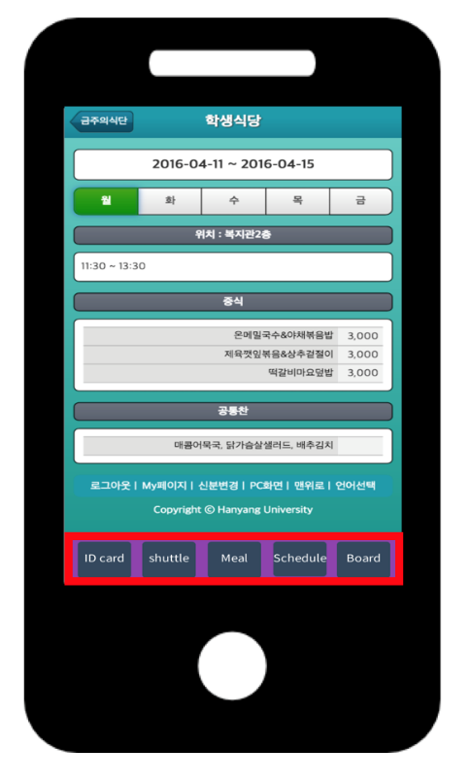

Use Case 8. Page Switch

Slide 43
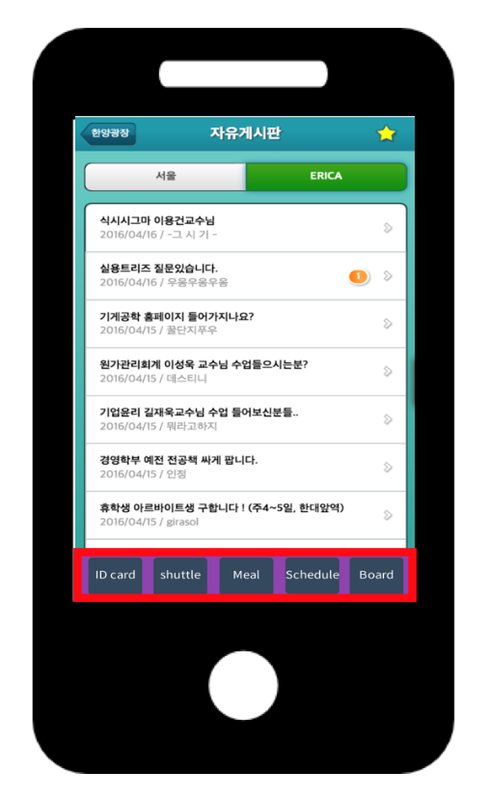
Use Case 8. Page Switch

Slide 44
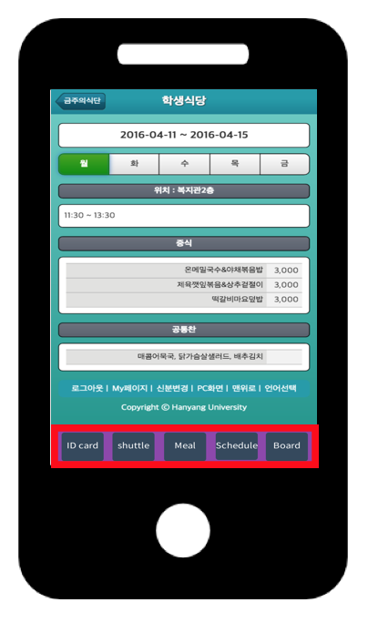

Use Case 8. Page Switch
Intuitive One Click
Access All Category Successfully

Slide 45
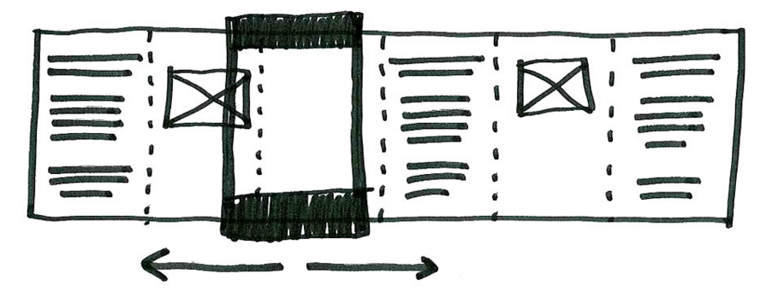
Use Case 8. Page Switch
Non-functional req.
The buttons are showed in a row at the bottom of the application.
The buttons are at the bottom of the application whatever page the application shows.

Slide 46
Analysis Model
4

Slide 47
Which?
Which diagrams are selected?
Use Case Diagram
Activity Diagram

Slide 48
Why?
Why are we select these diagrams?
Because…
HYUⓔmini is Activity-Oriented Application.

Slide 49
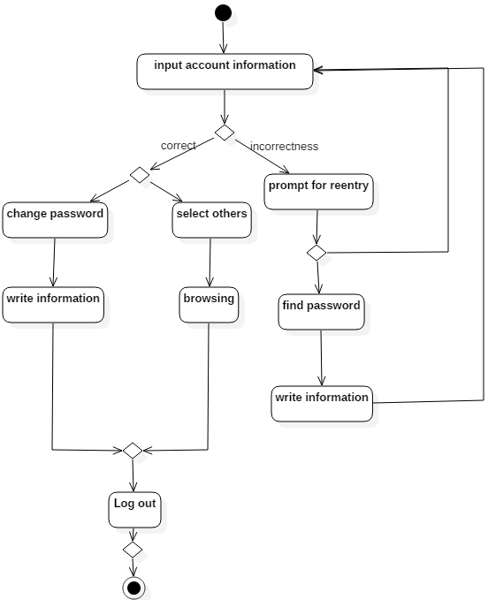
Use Case 1. Login/Logout
Activity Diagram
Log in
Log out
Find password
Change password

Slide 50
Use Case 1. Login/Logout
Sign up
In this application, we don't need it.
Find password
for students who forget their password
Change password
for student who did not change password for long time

Slide 51
Use Case 2. Main Page

Slide 52
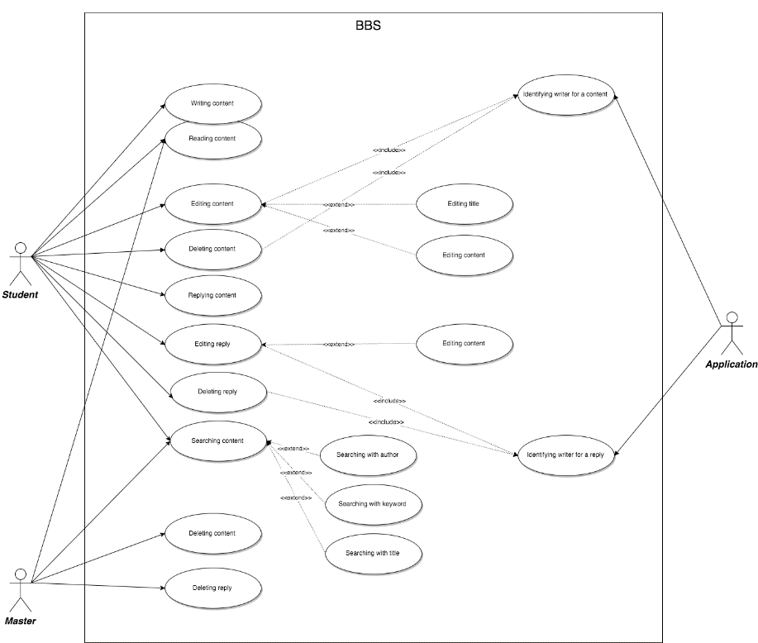
Use Case 3. BBS

Slide 53
Use Case 4. School Bus Schedule
Use Case 4. School Bus Schedule
Use Case Diagram과 Activity Diagram 올려주세요.(Swimlane 말고요.)
필요하다면 추가로 슬라이드를 넣으셔도 좋습니다.

Slide 54
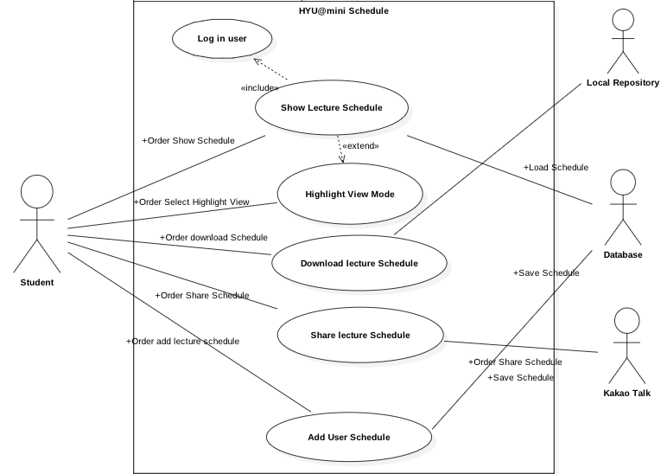
Use Case 5. Time Table
Use Case Diagram

Slide 55
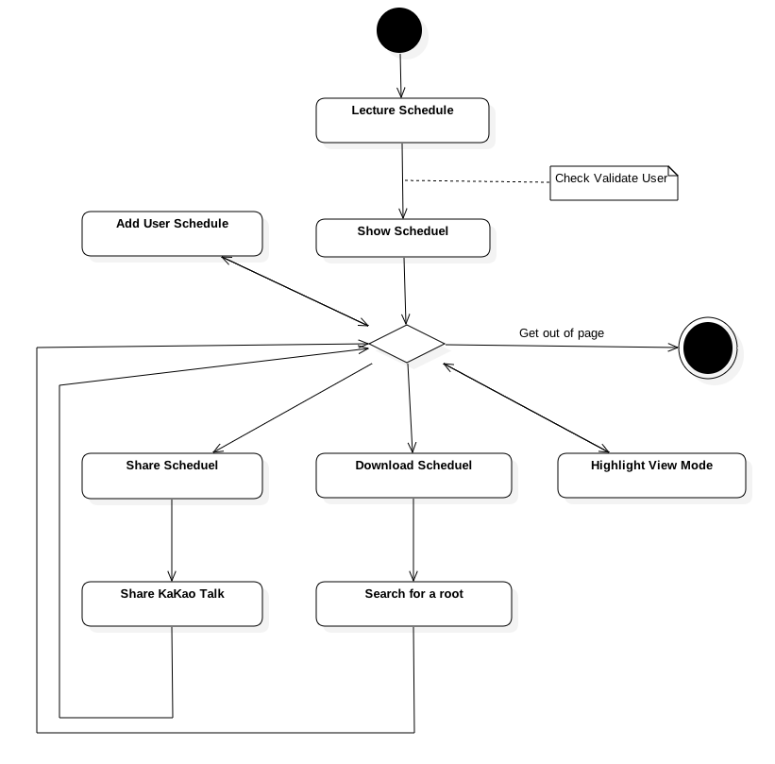
Use Case 5. Time Table
Activity Diagram

Slide 56
Use Case 6. Weekly Menu

Slide 57
Use Case7. Manager Page
Use Case 7. Manager Page
Use Case Diagram과 Activity Diagram 올려주세요.(Swimlane 말고요.)
필요하다면 추가로 슬라이드를 넣으셔도 좋습니다.

Slide 58
Use Case 8. Page Switch

Slide 59
Fin.

